Slide 1

Lab Assistant
Vinod Arya
Email: vinodsg76@gmail.com
Phone: +65 8272 4036

Slide 2
Overview
A medical diagnostic company provides medical tests services viz Blood Test, XRay etc to Customer. The company’s infrastructure is hosted in AWS Cloud.
Lab Assistant is a ChatBot, built using AWS Lex, handling following modules:
1. Customer queries: Answer User queries about company as location, working hours and diagnostic services provided
2. Admin: Enables Admin to perform Server maintenance as Starting and Stopping the EC2 instances

Slide 3
Components
Virtual Assistant has following components:
Github : https://github.com/vinodarya/labassistant/tree/master
1. Slack: Channel for Chat
2. Lex: Handles incoming Chats
3. Lambda: Holds Business logic, got following functions:
lmbdManageServer
LabAssustant
4. Dynamo DB: Store company’s overview and admin users, got following tables:
AboutUs: Keeps company overview
admin: Admin Users details
5. SES: Used for sending the Email
6. EC2: These are the Application Servers of Company

Slide 4
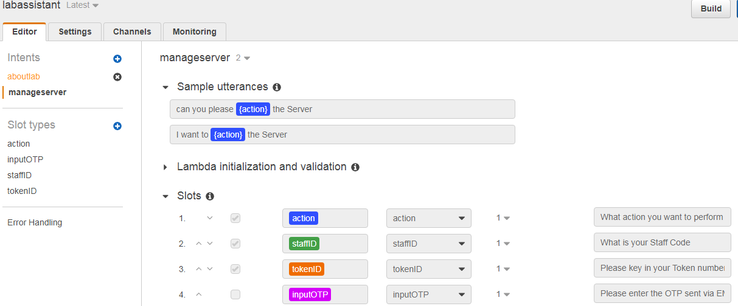
Components – Lex Bot

Slide 5
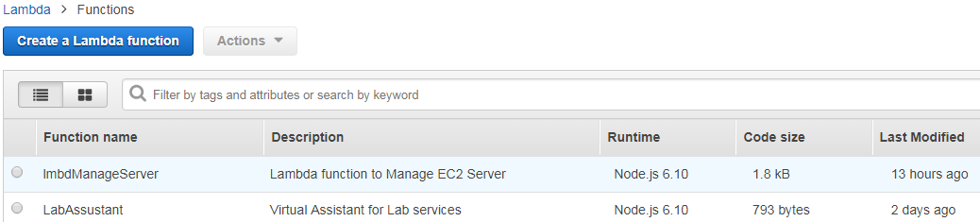
Components – Lambda function

Slide 6
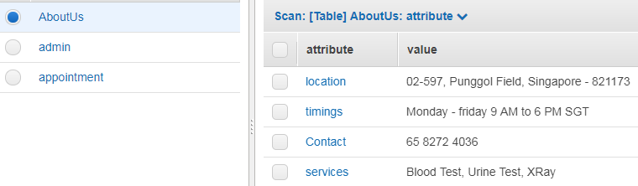
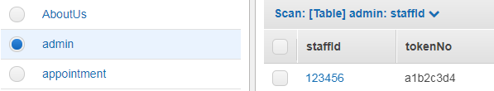
Components - Tables

Slide 7



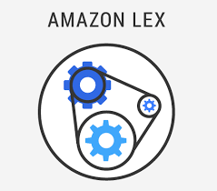



Architecture
OTP via EMail
Send OTP
Chat
Chats
Handle Intents
Search User/Answer
Start/Stop Server

Slide 8
Data Flow - Enquiry
1
2
3
4
8
7
6
5
1: User requests about Lab location via Slack
2: Slack passes the message to Lex
3: Lex initiates Lambda function to serve
4: Lambda queries Dynamo DB to get the location details
5: Dynamo DB returns the location details
6: Lambda passes the details Lex
7: Lex passes the response Slack
8: Slack displays the location details

Slide 9
Data Flow - Admin
12
7
8
9
6
5
11
4
1
2
3
10
13
14
15
19
18
17
16
1: User requests to start/stop the EC2 instance via Slack
2: Slack passes the message to Lex
3: Lex initiates Lambda function to serve
4: Lambda requests for Staff ID and Token number
5/6: Lex/Slack requests the details
7: User keys in Staff ID and Token number
8/9: Slack/Lex passes it to Lambda
10: Lambda validates in Dynamo DB
11: Lambda generates OTP and sends to SES
12: SES sends the OTP to User
13: User enters the OTP
14/15: Slack/Lex pass the OTP to Lambda
16: Lambda validates and Stops/Starts EC2
17/18/19: Lambda/Lex/Slack intimates User

Slide 10
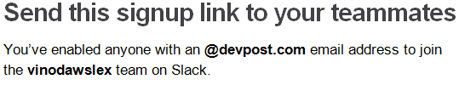
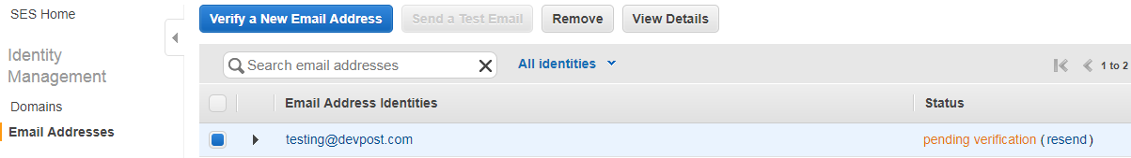
Testing
Step 1: Join the slack group: vinodawslex
Step 2: Verify the Email Address via clicking the verification link sent
Step 3: Login to slack

Slide 11

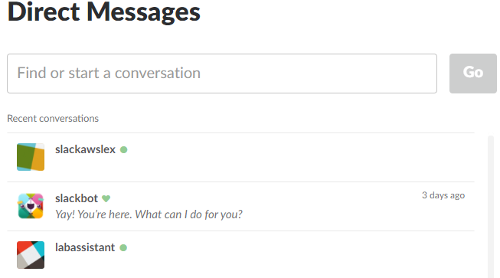
Testing
Step 4: Add labassistant bot using Direct Message + icon

Slide 12
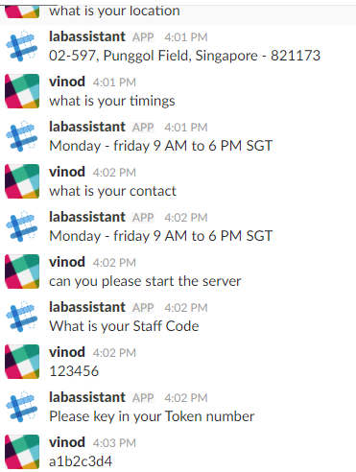
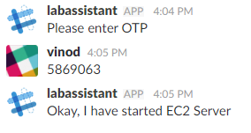
Testing
You can ask following:
What is your location
What is your timings
What is your contact
To Start/Stop the EC2 server
Input: Can you please start the server
Enter Staff Code as 123456
Enter Token number as a1b2c3d4
Wait for OTP in Email at testing@devpost.com
Enter the OTP received in Email

